Slide 1
Javascript and the Functional Programming paradigm
Yoav Rubin
@yoavrubin

Slide 2
Agenda
Intro
  Functional programming
    What, why, why now
  Javascript
    Basic syntax
    A little about functions
Diving in
  Inner functions
  Higher order functions
  Delayed execution

Slide 3
Intro

Slide 4
What is functional programming
A programming paradigm
  A way to look and understand problem
    analysis
  A way to describe problem via software
    modeling
  A way to describe solutions via software
    programming
Object oriented, procedural …
  Each has its pros and cons

Slide 5
“I suppose it is tempting, if the only tool you have is a hammer, to treat everything as if it were a nail”
Abraham Maslow

Slide 6
Why functional programming
Higher level of programming
  Faster to develop
  Simpler to test
A good software person should know more then one paradigm
MUST

Slide 7
Why now functional programming
Hardware wise:
  Multi-core means concurrency is unavoidable
Software wise:
  Future application
  Explosion of data
Skill wise:
  Multi aspects problem solving

Slide 8
Javascript
To study a paradigm, we need a language
We’ll use the Javascript programming language
  Because Javascript is everywhere

Slide 9
Atwood’s law:
“any application that can be written in Javascript, will eventually be written in Javascript”
http://www.codinghorror.com/blog/2007/07/the-principle-of-least-power.html

Slide 10
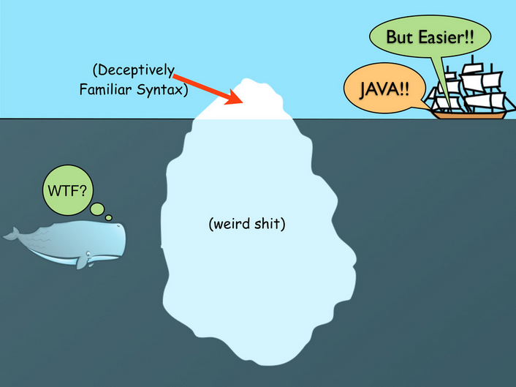
General syntax

Slide 11
Types
Numbers
Strings
Booleans
Objects
  Arrays
  Functions

Slide 12
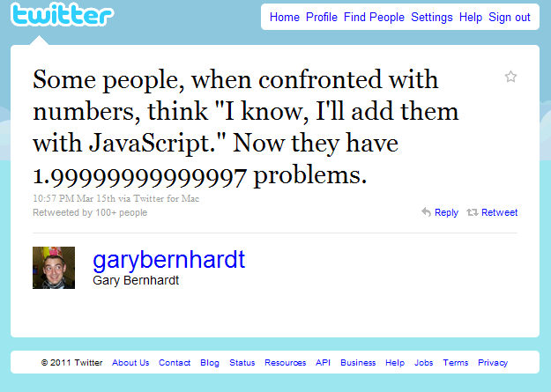
Numbers
Only one number type exists
64 bit floating point
  No integers
  10 / 3 = 3.3333
As with all floats, does not map well to common sense arithmetic
  0.1 + 0.2 == 0.3 //=> false
  2⁵³+1 == 2⁵³ //=> true

Slide 13
Booleans
true
false

Slide 14
Type system
Strongly typed (loose definition)
  With clear coercion rules
Dynamic typing
  The type is not declared
    var a = 3; // number
  Changing the variable’s content changes its type
  a = ‘s’; // string

Slide 15
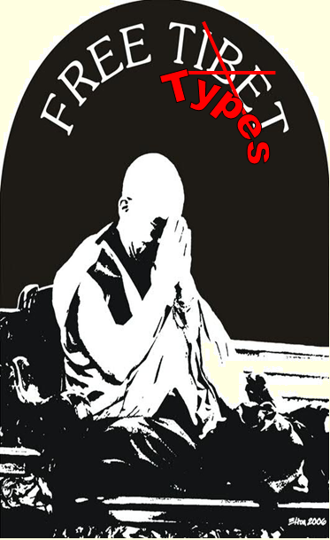
(From the tyranny of the compiler)

Slide 16
Objects
An object is a collection of fields
  Data (members)
  Functions (methods)
Each field has a name which is unique in that object

Slide 17
Objects are maps
An object is a set of mappings between a name of a field (key) to the field (value)
anObject.fieldName = 3;
anObject[“fieldName”] = 3;

Slide 18
Objects are maps
The mapping can be changed at any given time
  It is possible to add and remove fields
  It is possible to change the mapping of keys to fields
    Replace a method with another method
    Replace a member’s value with another value
    Replace a method with a member
    Replace a member with a method

Slide 19
Arrays
Arrays are objects
  No memory continuum
Indices are converted to an equivalent string keys
  arr[1] === arr[“1”]
    Very efficient for sparse arrays
Upon declaration, there is no need to provide the array’s length or the type of its elements

Slide 20
Arrays
Arrays are objects
  Have methods
  Have members
All objects are maps
  Can add fields
  Can add methods
Fields whose keys are integers gain “special treatment”

Slide 21
Array as linear data structures
Stack
  <theArray>.push(a,b,…)
    Adds elements at the end
  <theArray>.pop()
    Removes and returns the last element
Queue
  <theArray>.unshift(a,b,…)
    Adds elements at the front
  <theArray>.pop()
    Removes and returns the last element

Slide 22
Functions

Slide 23
Functions are objects
Have members
  e.g., length : the number of arguments in the function’s declaration
Have methods
  E.g., toString : returns a string containing the function’s signature and body

Slide 24
Functions are objects
function add(a,b){
return a+b;
};
add.length;// 2
add.toString(); // “function add(a,b){return a+b;}”

Slide 25
Functions are objects
Can be assigned to a variable
Can be part of an object or an element of an array
Can be sent as arguments to a function
Can be returned as a return value from a function

Slide 26
Functions are objects, with the capability to be executed

Slide 27
Defining a function
  function fName(params) {
  <statement>*
  };
var fName = function (params){<statement>*}
var fn = function fName(params){<statement>*}

Slide 28

Write a function that uses recursion and calculates the fibonacci value of a number

Slide 29
Classic solution
function fib(n){
if (n <2)
return n;
return fib(n-1) + fib(n-2)
}
fib(10) results in 177 calls to the fib function (time complexity - O(2^{n}) )

Slide 30
How can we do better ?

Slide 31
Other functional mechanisms:
Inner functions

Slide 32
Inner functions
A function can be defined inside another function
In that case computation in the inner function can access all the variables / data that is part of the outer function

Slide 33
Fibonacci using inner function
function fastFib(n){
var memo = [0,1];
var fib = function(n){
var result = memo[n];
if(result !== undefined) return result;
result = fib(n-1) +fib(n-2);
memo[n] = result;
return result;
}
return fib(n);
}
fastFib(10) results in 9 calls to the fib function (time complexity - O(n))
An inner function

Slide 34
Inner functions
FastFib
Memo
The Fib function
Calculate if value is not in the cache
Maintain the cache
This pattern is nicknamed memoization

Slide 35
Higher Order Functions

Slide 36
Higher order functions
Functions can be sent as an argument to another function
Functions can be returned as a return value of a function

Slide 37
Higher order functions - metaphorically
Function is a tool to work with
Value is a result of working with a tool
Function that receive a function is a tool that needs another tool to operate with
  Think of a drill
Function that receives a value and returns a function is a tool that needs configuration in order to operate
  Think of a screwer
A function that returns a function is a machine that creates tools
  Think of a machine that creates drills

Slide 38


Return value\ arguments | value | function
value
function

Slide 39
Question
s
Find whether a binary tree is a binary search tree
Find whether a binary tree is a balanced tree

Slide 40
Question
s
Find whether a binary tree is a binary search tree
  Traverse the tree, for each node:
    Get range of left node
    Get range of right node
    Calculate node’s range and it’s validity, return the range (if valid), some marker otherwise
Find whether a binary tree is a balanced tree
  Traverse the tree, for each node:
    Get height of left node
    Get height of right node
    Calculate if the node is balanced, return the height (if balanced) some other marker otherwise

Slide 41
Question
s
Find whether a binary tree is a binary search tree
  Traverse the tree, for each node:
    Get range of left node
    Get range of right node
    Calculate node’s range and it’s validity, return the range (if valid), some marker otherwise
Find whether a binary tree is a balanced tree
  Traverse the tree, for each node:
    Get height of left node
    Get height of right node
    Calculate if the node is balanced, return the height (if balanced) some other marker otherwise

Slide 42
Functions that accept functions and return a value
The accepting function provides the syntactic skeleton of the computation
The added function provides the semantics for the calculation
Implementation of the “Strategy design pattern”

Slide 43
Working on arrays
A primary usage for this kind of functions is to operate on arrays
The array object is Javascript has several methods that accept functions to operate on the elements of the array

Slide 44
Reduce
Reducing an array into a single value
Accumulative computation using a function that:
  Operates on a previously computed result and an element of the array
  Returns a result that is used for the next iteration with the next element of the array

Slide 45
Reduce
arr.reduce(someFunction, seed)
  someFunction accepts:
    accumulatedResult
    currentItem
    currentIndex
    theArray
The seed is the accumulated result used with the first item
reduce goes from index 0 to arr.length-1
reduceRight goes from index arr.length-1 to 0

Slide 46
[2,4,6,8,10].reduce(
function add(res, i){ return res+i;},
5 )
The reducing function
The seed

Slide 47
[2,4,6,8,10].reduce(
function add(res, i){ return res+i;},
5 ) ➔ 35

Slide 48
[2,4,6,8,10].reduce(add, 5)
2
4
6
8
10
5
fn
7
fn
11
fn
17
fn
25
fn
35

Slide 49
Array.filter(predFunc)
Returns an array containing part of the elements in the given array
  Only the items that predFunc allowed
predFunc = function(item, itemIndex, arr)
Returns true if we want to keep that item
  False otherwise

Slide 50
[1,2,3,4,5].filter(
function isOdd(item){
return item%2 == 1;}
)
The predicate function

Slide 51
[1,2,3,4,5].filter(
function isOdd(item){
return item%2 == 1;}
) ➔ [1,3,5]

Slide 52
[1,2,3,4,5].filter(isOdd)
1
2
3
4
5
fn
[1]
fn
[1]
fn
[1,3]
fn
[1,3]
fn
[1,3,5]

Slide 53
Array.map(mapFn)
Returns a new array, in which each value_{i} is a result of applying the mapping function on value_{i} of the initial array
  newArray[i] = mapFn(arr[indx], indx, arr)

Slide 54
[1,2,3,4,5].map(
function add3(item){
return item+3;}
)
The mapping function

Slide 55
[1,2,3,4,5].map(
function add3(item){
return item+3;}
) ➔ [4,5,6,7,8]

Slide 56
[1,2,3,4,5].map(add3)
1
2
3
4
5
fn
[4]
fn
[4,5]
fn
[4,5,6]
fn
[4,5,6,7]
fn
[4,5,6,7,8]

Slide 57
What is it good for ?
var res = arr.filter(pred).map(mapFn);
How can we do it imperatively?

Slide 58
What is it good for ?
var res = arr.filter(pred).map(mapFn);
  var res = [];
  for(var i=0;i<arr.length;i++){
  if(pred(arr[i]))
  res.push(mapFn(arr[i]));
  }

Slide 59
What is it good for ?
var res = arr.filter(pred).map(mapFn);
  var res = [];
  for(var i=0;i<arr.length;i++){
  if(pred(arr[i]))
  res.push(mapFn(arr[i]));
  }

Slide 60
What is it good for ?
var res = arr.filter(pred).map(mapFn);
  var res = [];
  for(var i=0;i<arr.length;i++){
  if(pred(arr[i]))
  res.push(mapFn(arr[i]));
  }

Slide 61
What is it good for ?
var res = arr.filter(pred).map(mapFn);
  var res = [];
  for(var i=0;i<arr.length;i++){
  if(pred(arr[i]))
  res.push(mapFn(arr[i]));
  }

Slide 62
What is it good for ?
var res = arr.filter(pred).map(mapFn);
  var res = [];
  for(var i=0;i<arr.length;i++){
  if(pred(arr[i]))
  res.push(mapFn(arr[i]));
  }

Slide 63
What is it good for ?
var res = arr.filter(pred).map(mapFn);
  var res = [];
  for(var i=0;i<arr.length;i++){
  if(pred(arr[i]))
  res.push(mapFn(arr[i]));
  }
That’s just boilerplate code !!!

Slide 64
Same applies also when adding reduce to the mix

Slide 65
Few more array methods

Slide 66
Arr.forEach(feFunc)
Doesn’t return anything (returns undefined)
Executes feFunc on each element in the array
Used when we need the side-effect of the computation
  Modifying some external variable, printing…

Slide 67
Questioning the array
arr.some(predFunc)
  Is there an element in the array that the predicate returns true for
  predFunc = function(item){…}
arr.every(predFunc)
  Does the predicate returns true for all the elements in the array
  predFunc = function(item){…}

Slide 68
Return value\ arguments | value | function
value
function

Slide 69
More about functions – lexical scoping
Computation done in an inner function can access data found in the outer function
Such an access creates a construct called Closure

Slide 70
Closures
Remains alive even when the execution of the outer function was finished
  E.g., The inner function was the return value
(The stack frame is kept on the heap)

Slide 71
Fibonacci using closure
function fastFibMaker(){
var memo = [0,1];
var fib = function(n){
var result = memo[n];
if (result !== undefined) return result;
result = fib(n-1) +fib(n-2);
memo[n] = result;
return result;
}
return fib;
}
var theFib = fastFibMaker(); // returns a function
theFib(10); // 9 calls to fib
theFib(10); // 1 call to fib

Slide 72
FastFibMaker
memo
Fib

Slide 73
FastFibMaker
memo
var fastFib
Fib

Slide 74
Closures allow us to attach data to functions

Slide 75
Return value\ arguments | value | function
value
function

Slide 76
Functions that accept functions as arguments and return a function
Example from math: derivative
  Accepts one function
  Returns another
  Derivative(f(x)) = (f(x+delta) – f(x)) / delta

Slide 77
What is it good for
Composing a computation hierarchy
  Pipeline execution
  Fan out execution

Slide 78
Computational hierarchy
A pipeline function receives several functions, pipes them and return the pipe
add (a,b)
Math/Sin (x)
square (x)
Pipeline (funcs)
sin²(a+b)

Slide 79
Computational Hierarchy
A Fan out function receives several functions, and return a function that for a given input, returns all the results of applying the initial functions on them
+
-
/
*
%
fanOut
fannedArithmetics (a,b)
fannedArithmetics(10,4) = [14, 6, 2.5, 40, 2]

Slide 80
Reminds you of anything?

Slide 81
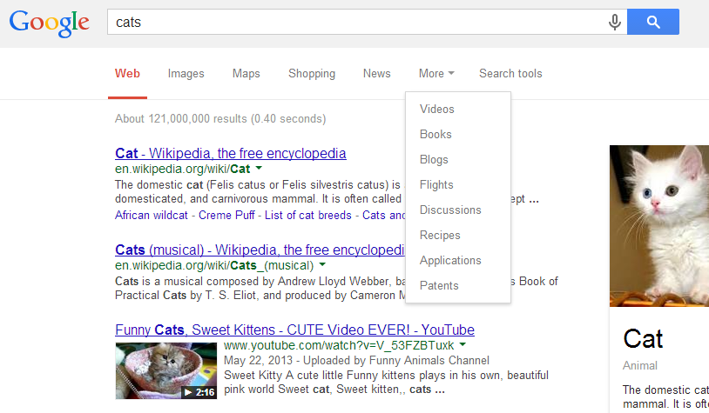

Slide 82
Delayed execution

Slide 83
What is it good for
A function call is built of:
  Saying what computation should be performed
  Telling it to be executed now
Sometimes there’s a need to separate between the two

Slide 84
Improving recursion

Slide 85
function factorial (n) {
if(n<2) return n;
return n*factorial(n-1);
}
What’s the problem here?
  Can’t control the depth of the recursion
  How can we make it better?

Slide 86
function factorial (num) {
function fact(accum, n){
if(n<2) return accum;
return fact(accum*n, n-1 );
}
return fact(1, num);
}
What have we changed?
  Using inner function to compute the factorial
  Moved the recursive call to be the last thing that the function
Still, we can’t control the recursion depth

Slide 87
Where’s the problem ?
function factorial (num) {
function fact(accum, n){
if(n<2) return accum;
return fact(accum*n, n-1 );
}
return fact(1, num);
}

Slide 88
Where’s the problem ?
function factorial (num) {
function fact(accum, n){
if(n<2) return accum;
return fact(accum*n, n-1 );
}
return fact(1, num);
}

Slide 89
Where’s the problem ?
function factorial (num) {
function fact(accum, n){
if(n<2) return accum;
return fact(accum*n, n-1 );
}
return fact(1, num);
}
We define the calculation
and say that it should be
performed now

Slide 90
Separate the defining of the recursive call from executing it
function factorial (num) {
function fact(accum, n){
if(n<2) return accum;
return function() { return fact(accum*n, n-1);};
}
return function() {return fact(1, num);};
}
What have we changed?
  Wrapped the recursive call with another function
We need someone to unwrap the added wrapping function
  Call it

Slide 91
Separate the defining of the recursive call from executing it
function factorial (num) {
function fact(accum, n){
if(n<2) return accum;
return function() { return fact(accum*n, n-1);};
}
return function() {return fact(1, num);};
}
What have we changed?
  Wrapped the recursive call with a function
    Not a function call !!
  But now the recursive call does not get called
  Executing the wrapping function would invoke the recursive call

Slide 92
Unwrapping
function trampoline (f) {
while(isFunction(f))
f = f();
return f;
}

Slide 93
Separate the defining of the recursive call from executing it
function trampoline (f) {
while(isFunction(f))
f = f();
return f;
}
function factorial (num) {
function fact(accum, n){
if(n<2) return accum;
return function() {return fact(accum*n, n-1);};
}
return trampoline(
function(){ return fact(1, num);}
);
}
What have we changed?
  Called trampoline to unwrap

Slide 94
trampoline with f(fact(1, 5))
Returning 120 from trampoline
Trampoline
if there’s red f – call it
otherwise return what it got
f(fact(5, 4))
f(fact(20,3))
f(fact(60,2))
120
fact(1,5)
fact(5,4)
fact(20,3)
…
fact(120,1)
Function call
Return value is a function
Return value is a value

Slide 95
Summary – key takeaways
In Javascript functions are objects are maps
Functions are tools, you can build tools from other tools, you can build tools that create tools
Don’t fear recursion as anonymous functions can do magic

Slide 96
Thank You

